Slide 1

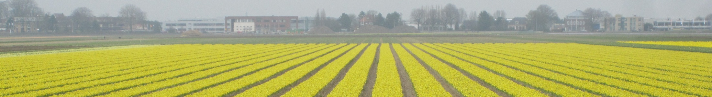

Dan Bolser, EMBL-EBI
trans-National Infrastructure for Plant Genomic Science
Triticeae in Ensembl Plants Poznań, 27th-28th June 2013

Slide 2
Introduction

Slide 3
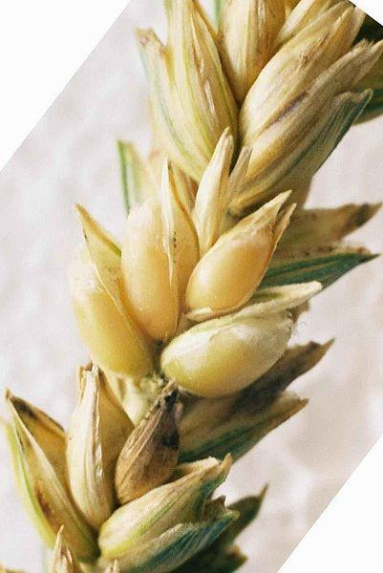
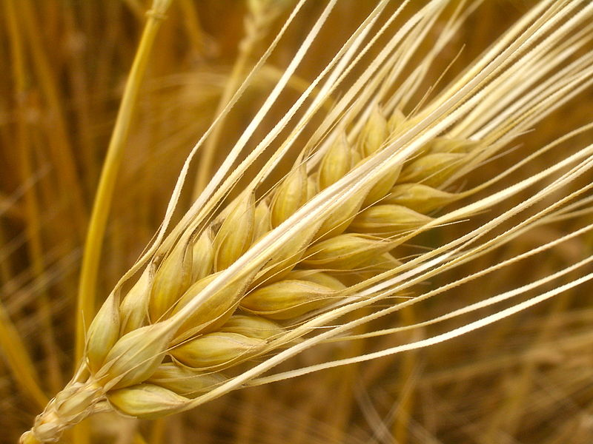
Triticeae crops
Wheat
Barley
Bread wheat
Triticum aestivum
Accounts for 20% of human calories and protein.
Hexaploid (AA/BB/DD)
7 chromosomes
17Gb genome
~80% repeats
Currently only a fragmented assembly is available.
Barley
Hordeum vulgare
An important cereal and model for adaption.
Diploid
7 chromosomes
5.3Gb Genome
~80% repeats
Integrated gene-space and physical map.

Slide 4

Triticeae crops
Wheat
Barley

Slide 5
Wheat

Slide 6
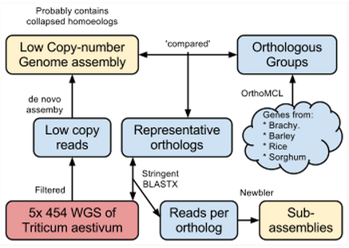
Wheat sequence data
Gene-space ‘sub-assemblies’
1,394,281 sub-assemblies
contigs and singletons
Data provided:
“in the syntenic context of Brachypodium distachyon”
117,411 (89%) mapped

Slide 7
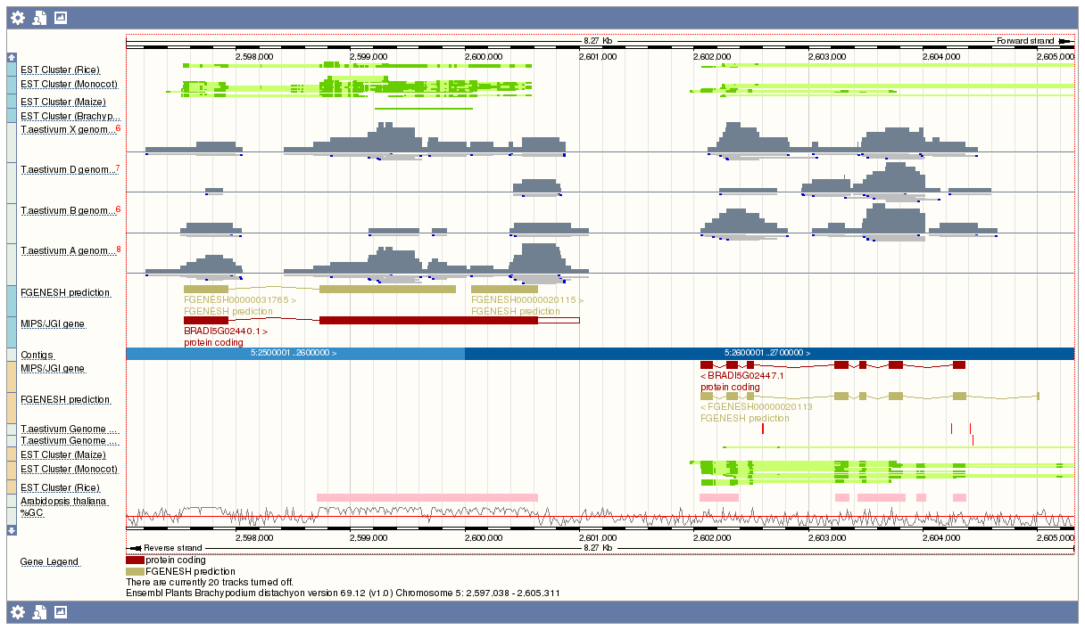
Wheat
Wheat sub-assemblies, classified into A, B, D (and X) genomes, aligned to Brachypodium distachyon in Ensembl Genomes

Slide 8
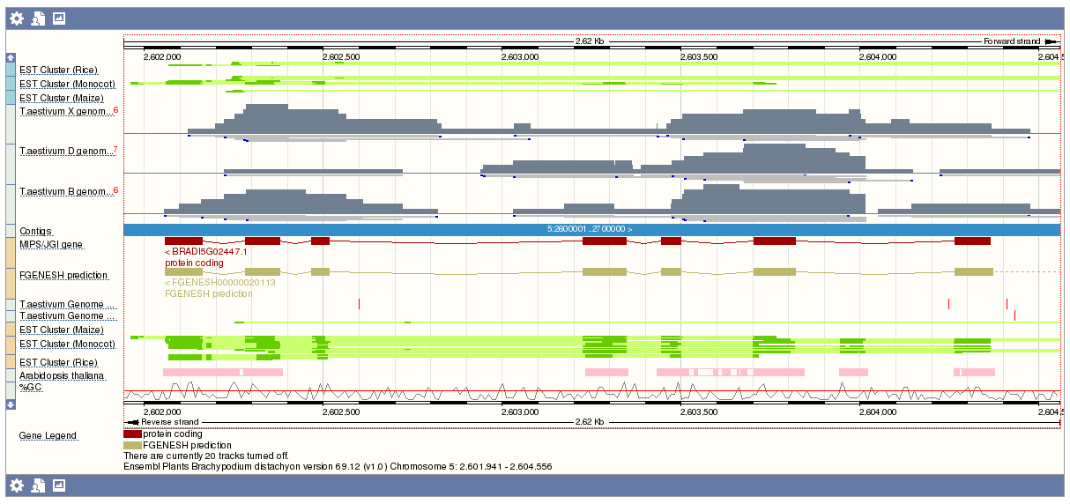
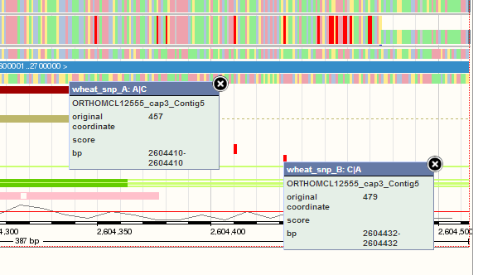
Wheat sub-assemblies and homoeologous SNPs
Wheat sub-assemblies, classified into A, B, D (and X) genomes, aligned to Brachypodium distachyon in Ensembl Genomes, showing homoeologous SNPs (variations between the A, B and D genomes).

Slide 9
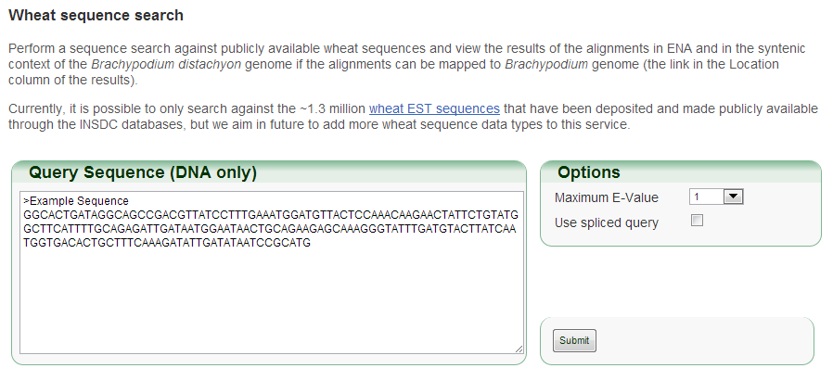
Wheat sequence search
http://plants.ensembl.org/Triticum_aestivum

Slide 10
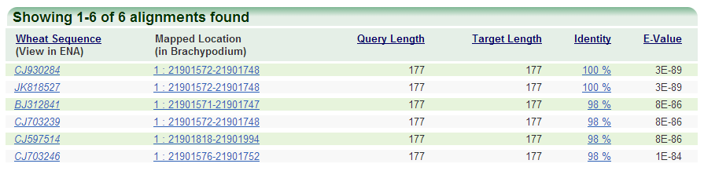
Wheat sequence search
http://plants.ensembl.org/Triticum_aestivum
Query
Wheat sequence
Brachy-podium

Slide 11
Barley

Slide 12
Barley NOTES
Gene-space assembly
Integrated physical map
Genome browser
Chromosomes and genes in Ensembl Plants
All the ‘features’ of Ensembl,
Trees,
Functional annotation

Slide 13
Barley – Sequence data
cv. Morex
5x Illumina GAII
300b PE
2.5kb PE
376k contigs > 1kb
100k directly integrated into PM
+ a hierarchical approach for other sequence data

Slide 14
Barley – Gene & physical map data
Gene calls
Genes
167Gb of RNA-Seq
29k fl-cDNAs
79k 'transcript clusters'
26k 'High Confidence' genes (by homology)
95% anchored on WGS contigs
Physical map data
Fingerprinted BACs
600k BACs (14x) in six different BAC libraries
10k FPC contigs with estimated n50 of 900kb
500k x2 BES, 6k WGS
Markers
3000 gene-based
500k sequence tags

Slide 15
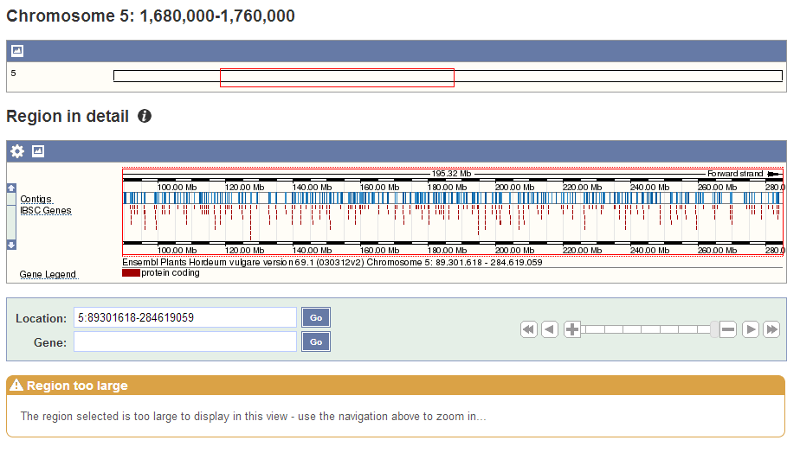

Slide 16
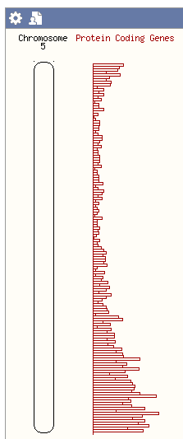

Slide 17
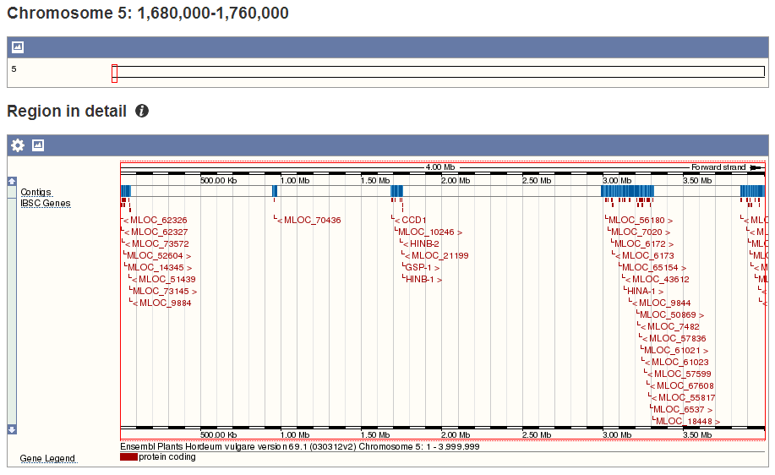

Slide 18
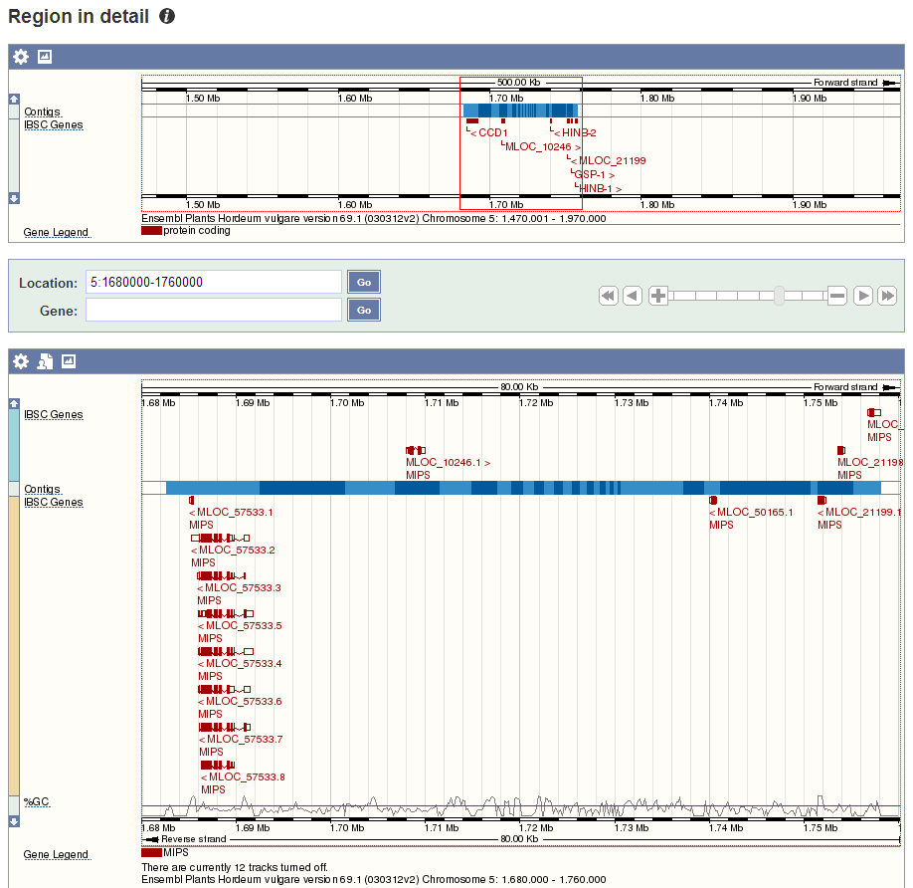

Slide 19
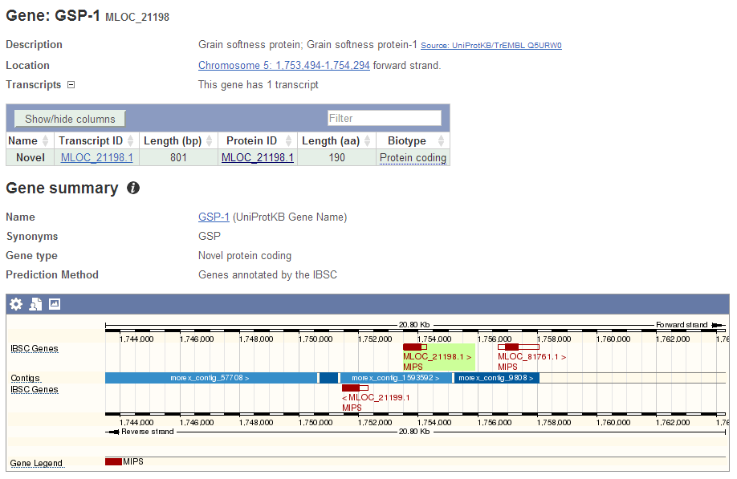

Slide 20
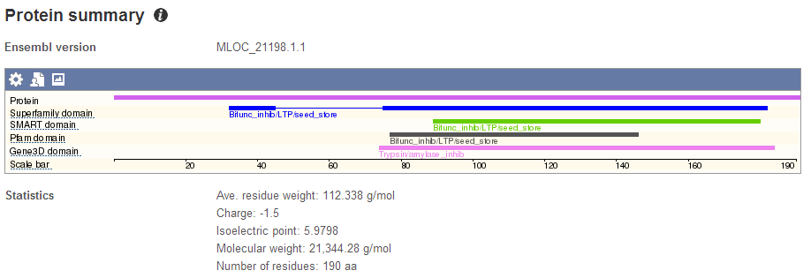
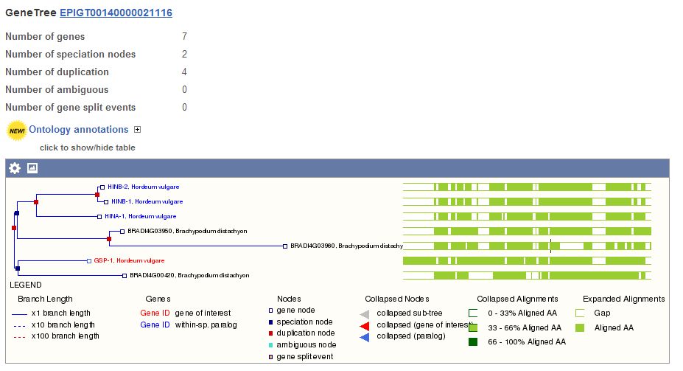

Slide 22
Summary

Slide 23
Wheat
Barley
Too fragmented for a genomic assembly
Sub-assemblies and homoeologous SNPs shown in the syntenic context of Brachypodium distachyon
Small model grass
26,000 high confidence genes called.
90% anchored on chromosomes.
Standard Ensembl Plants analysis pipelines can be run…
Compara
Functional annotation
Variation

Slide 24
Coming soon…
Wheat
Barley
Bread wheat ESTs and genomic sub-assemblies aligned to both brachypodium and barley
Wheat sequence search returns mapped hits for both
Two new wheat genomes added
Revised and refined variation data for 11 genotypes.
RNA-Seq data.

Slide 25
Acknowledgements

Slide 26
Questions?

Slide 27
Alignment stats for wheat sub-assemblies on brachypodium
 | Sub-Assemblies (88% singletons) | Aligned to brachy. | Full length alignment?
A | 123,383 (13%) | 115,804 (94%) | 114,375 (99%)
B | 158,440 (17%) | 141,278 (89%) | 138,438 (98%)
D | 156,976 (17%) | 144,810 (92%) | 142,635 (98%)
X | 510,480 (54%) | 412,385 (81%) | 402,049 (97%)
Total | 949,279 | 814,277 (86%) | 797,497 (98%)

